Slide 1




College Majors, Earnings, and Employment in Maryland and Virginia
Presented by:
Qian He

Slide 2

Dataset Overview
Data Period:
2024 MD
Datasets: 2024 American Community Survey (ACS) Public Use Microdata Sample (PUMS) person-level data for Maryland and Virginia.
Source: U.S. Census Bureau.
Data Size:
62777 Observations
Main Variables:
8 Variables
Data Type:
Primary Dataset

Slide 3
Dataset Overview
Main variables: Annual earnings (WAGP), college major (FOD1P), sex (SEX), age (AGEP), education (SCHL), employment status (ESR), usual weekly work hours (WKHP), and state.
Data challenges: The data contain coded categories, missing values, unequal sample sizes across majors, and complex survey weights.
Data Period:
2024 VA
Data Size:
89404 Observations
Main Variables:
8 Variables
Data Type:
Secondary Dataset

Slide 4

Research Objectives
To examine how college major and demographic characteristics relate to earnings and employment among college graduates in Maryland and Virginia.
How does median wage vary across age groups for male and female college graduates in Maryland?
01
03
Which college majors have the highest median earnings in Maryland?
01
How do earnings differ between men and women in the four majors with the largest samples in Maryland?
02
04
How do median earnings differ between men and women across the eight selected majors in Maryland?
02

Slide 5
Research Objectives
How does median earnings for the same majors differ between Maryland and Virginia?
05
01
Is state still associated with earnings after accounting for major, sex, age, education, and work hours?
08
How does the gender earnings gap across majors differ between Maryland and Virginia?
06
02
How are college major, sex, age, and state associated with the likelihood of employment among college graduates in Maryland and Virginia who are in the labor force?
09
Is mean annual earnings significantly different between college graduates in Maryland and Virginia?
07

Slide 6

Tools
R
TIDYVERSE
GGPLOT2
Tableau

Slide 7
01
Small sample sizes in some majors
Risks & Mitigation
02
Coded or missing data
03
Unstable model estimates
Interpretation limits:
04

Slide 8
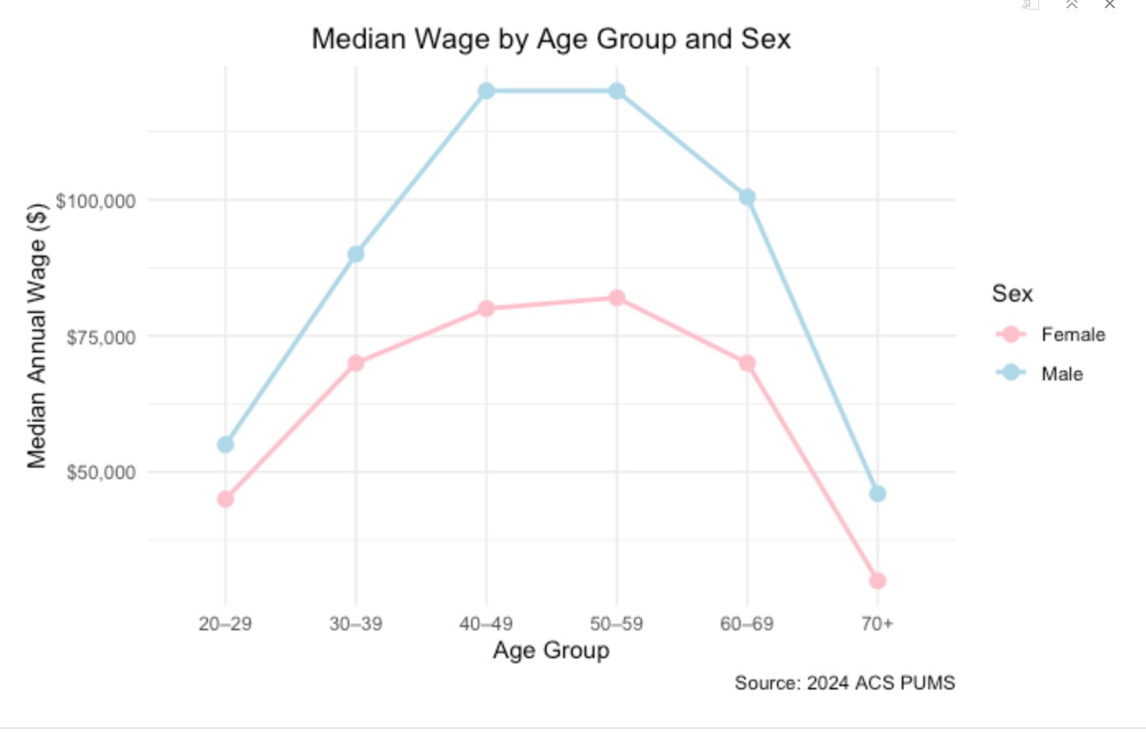

Visualization

Slide 9
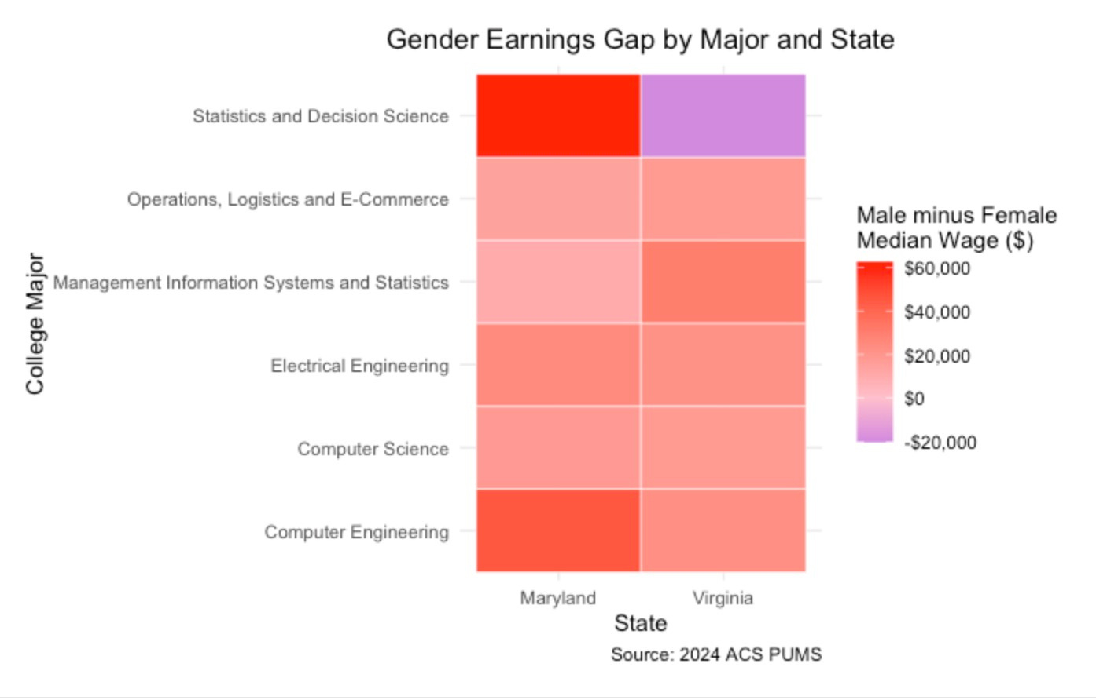
Visualization

Slide 10
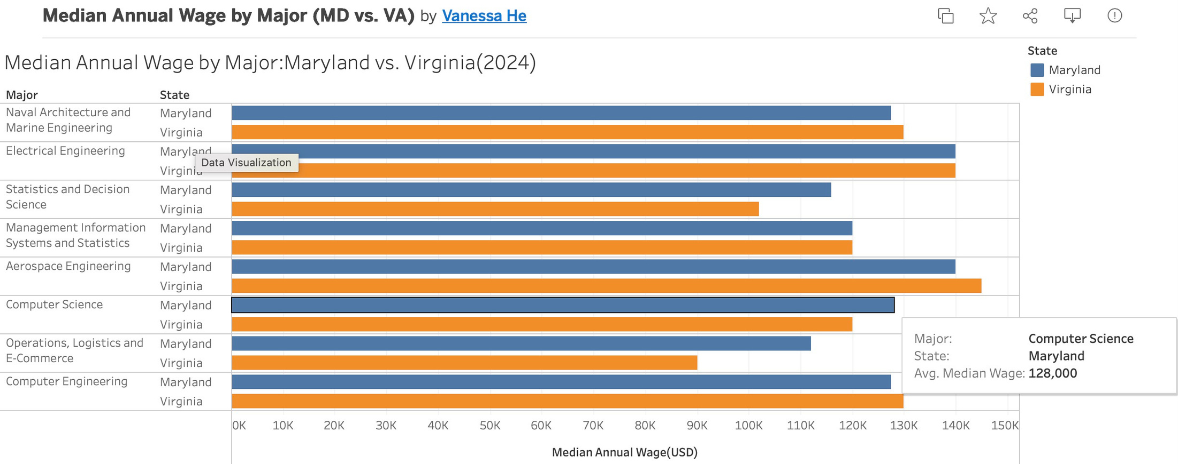
Visualization

Slide 11

Methods & Models
01
03
Descriptive statistics and visualizations to compare wages across majors, sexes, age groups, and states.
Multiple linear regression to examine associations with earnings while accounting for other factors.
02
04
t-test to compare mean earnings between Maryland and Virginia.
Logistic regression to examine employment status.

Slide 12

Milestones
01/
Sep–Oct 10| Completed: Topic and Initial Data Exploration
02/
Oct 21-22 | Completed: Project Plan and Research Questions
03/
Oct 26–Nov 6 | Data Preparation and Visualization Review
04/
Nov 9–20 | Tableau Dashboard and Statistical Models
05/
Nov 23–Dec 1 | Interpret Results and Complete the Report
06/
Dec 4–11 | Final Presentation and Submission

Slide 13
Thank
You

